Slide 1
Employment Agency
Bulgaria
High-level Conference, "The Active Labour Market Policies, Pillar of the European Year of Skills
Barcelona, 19-20 October 2023
Skills and Ability to Work in a Turbulent Environment
National Competence Assessment System
MyCompetence – the Bulgarian Experience

Slide 2
Why did we establish MyCompetence national system?
What are the challenges?
A change in the nature of work, changes labour market as well
Changes in occupations brought about by technologies
Soaring deficit and skills mismatch on labour market
Increasing necessity of adequate formal and informal education and continuous learning
Human potential has become crucial for competitiveness and growth

Slide 3
MyCompetence is a unique national network and an electronic system assisting human capital development in Bulgaria
OBJECTIVES:
Enhancing workforce capacity and adaptability to the changing labour market requirements
Matching skills seek and demand on labour market
Implementing modern and innovative HRM models resting upon competence-based approach
Building up a sustainable relationship between education, learning and labour market
Adapting employment policies to labour market demands
TARGET GROUPS: employers, managers, the employed, jobseekers, HR experts, educational institutions, labour market institutions, students

Slide 4
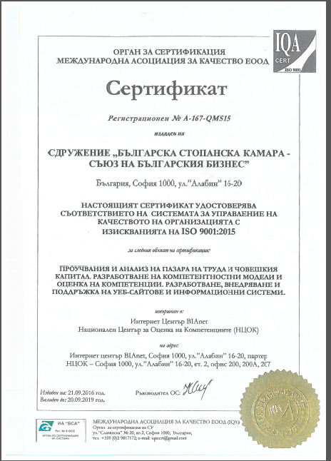
Verification of MyCompetence
2.5 million visitors at www.mycompetence.bg
45 000 active users – both physical and legal entities
21 universities and over 17 000 students
26 000 people successfully completed e-learning courses and used competence assessment tools
Positive feedback from leading experts in 13 countries – Great Britain, Germany, Israel, the Netherlands, Austria, Belgium, Italy, Spain, Portugal, Estonia, the Czech Republic, Slovakia, Romania

Slide 5
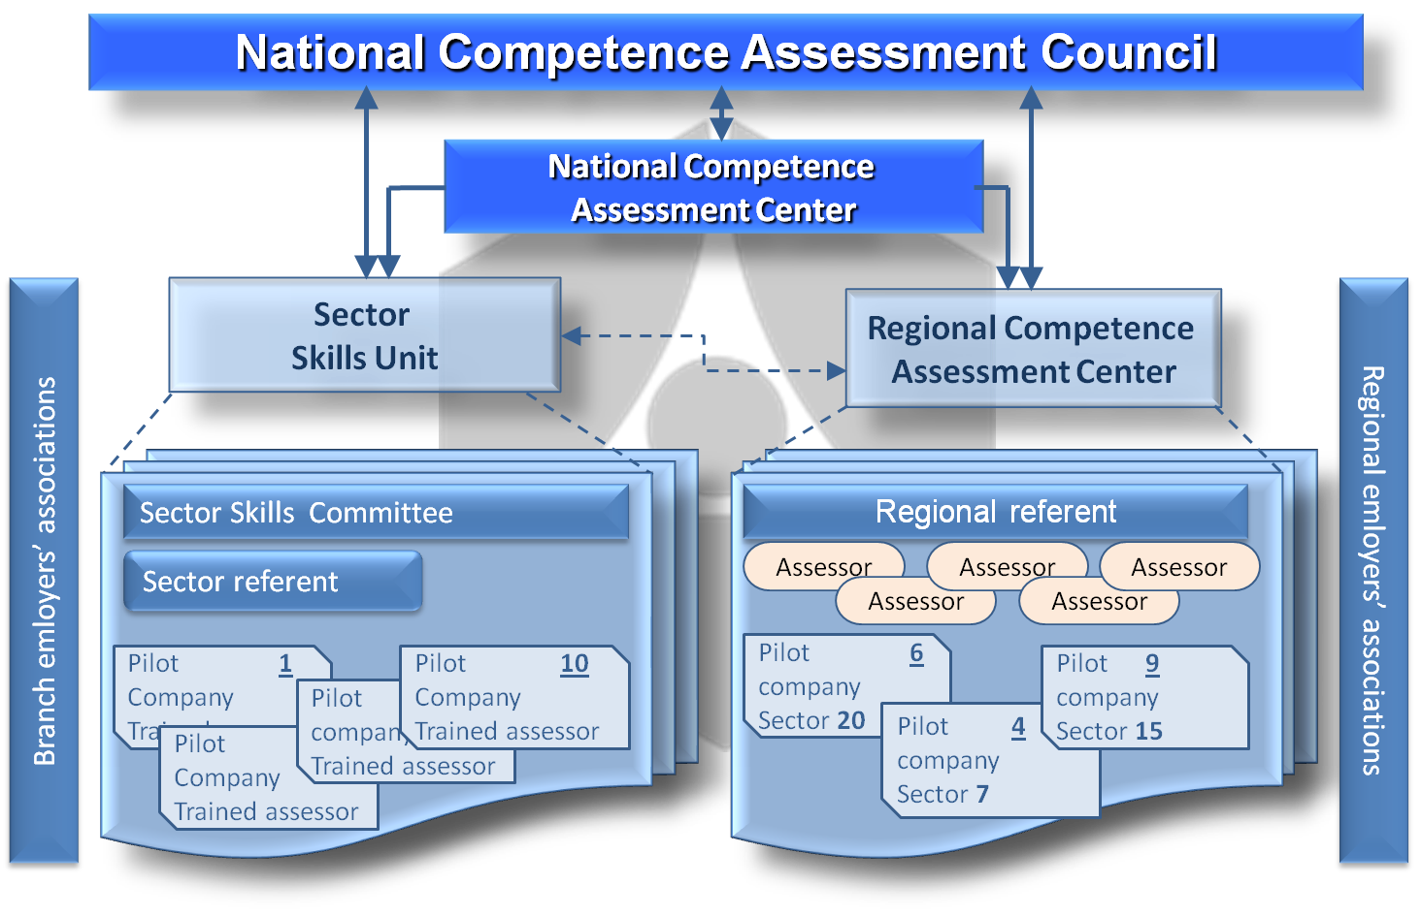
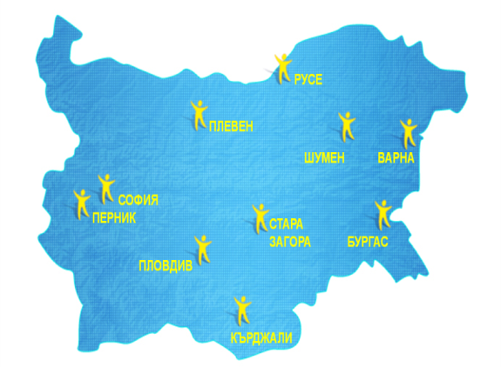
MyCompetence Infrastructure
A wide partnership network which aims to align the interests of both employers, trade unions and the State, as well as provide a close relation between education and learning and the labour market, encompassing the following:
25 Sector Skills Committees including over 300 participants – employers, managers, social partners, government bodies representatives, educational institutions representatives and other parties concerned
280 Pilot Enterprises
10 Regional Competence Assessment Centers
European Sector Councils on Employment and Skills

